Slide 1

Reading a novel
Different elements of a story

Slide 2

Elements of a story
What’s a ‘Theme’?
How do I quote?
How do I describe ‘Setting’?
How do I summarise a story in English?
How do I recognise the main character?
How do I describe the characters?

Slide 3
Theme
Central idea of the story
There can be multiple themes in 1 story
Theme
Plot

Slide 4
Theme
How to find the themes:
What happened? What were the conflicts? What was the most important moment in the book? How did the book end?
What is the subject? If you told a friend about your book, what would you tell?
What about the main character (protagonist)? How does he/she change? How does he/she relate to others?

Slide 5

Normality
Oppression
Friendship
Death
Survival
Adolescence
The supernatural
Good vs Evil

Slide 6

Quoting
Why quote?
To prove that you don’t use plagiarism
To support an answer to a question about your story
To show how the author uses language
How to quote?
Start your quote with quotation marks
End your quote with quotation marks
After your quote, write down the last name of the author and the page where your found the quote in brackets
E.g.: “The dog fell from the roof.” (Williams, 59)
“
“

Slide 7
Quoting
Harry always wanted to know what his parents were like: “He couldn't remember his parents at all. His aunt and uncle never spoke about them, and of course he was forbidden to ask questions. There were no photographs of them in the house.” (Rowling, 61)
The living conditions at his house were very poor, at least for him: “Harry was used to spiders, because the cupboard under the stairs was full of them, and that was where he slept.” (Rowling, 89)
Harry is very loyal to his friends: “But from that moment on, Hermione Granger became their friend. There are some things you can't share without ending up liking each other, and knocking out a twelve-foot mountain troll is one of them.” (Rowling, 178)

Slide 8
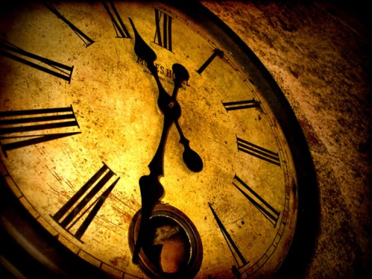
Setting
Time and Place are very important elements of a story. Together they are called the setting of a story.
Plot and characters are usually the most important elements in a story, setting is used to fit everything together.

Slide 9
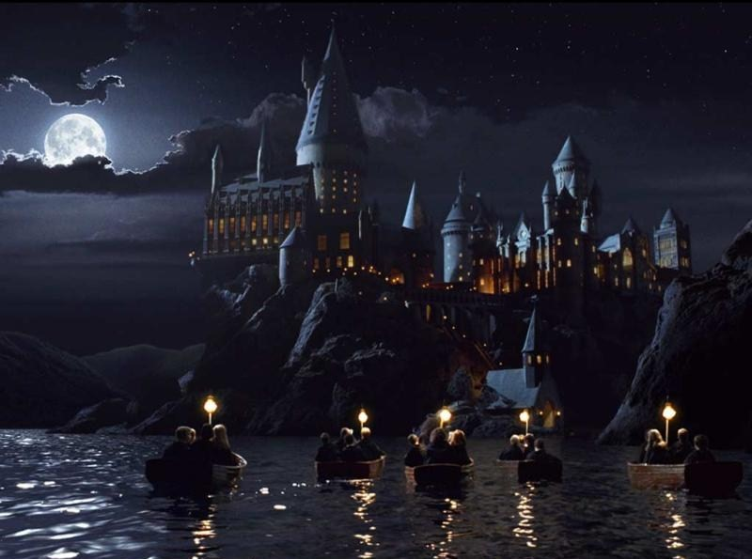
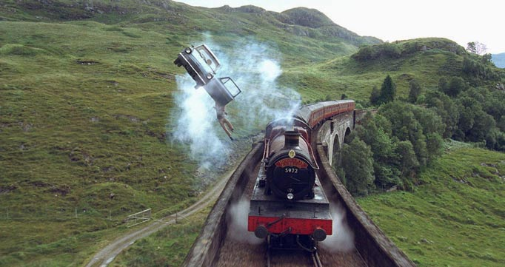
Time and place
Harry Potter

Slide 10
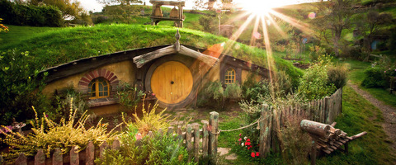
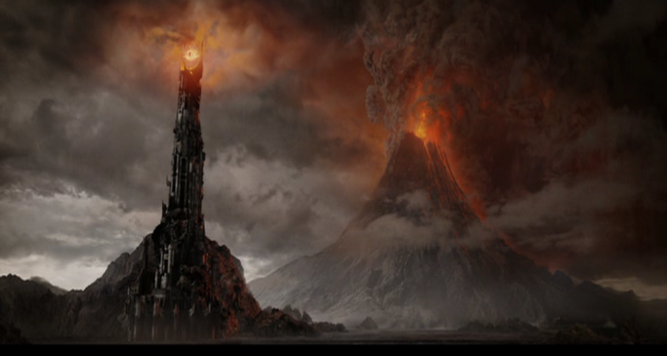
Time and place
Lord of the Rings

Slide 11
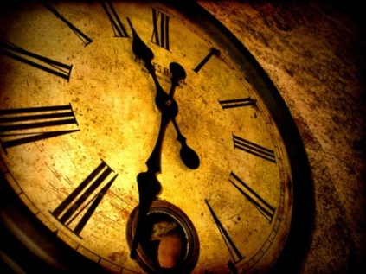
Time and place
Do’s:
Always give a description of ‘time’ of your book:
When does the story take place? In the past / present / future. Try to be as specific as possible.
Not: it takes place in the past.
But: My story takes place in the beginning of the 16th century.
Include senses (hearing, tasting, smelling, touching, seeing) in your description. This will make it more vivid.
Always give a description of ‘place’ of your book:
Where does the story take place? In a forest, at a beach, in a castle, on a different planet, in a city etc.
Not: it takes place in a city.
But: my story takes place in a very big city with a lot of people, tall skyscrapers and a lot of criminals.

Slide 12
Time and place
Don’t ‘s:
Don’t give a very small description of time and place. If you tell something about your book, give a couple of details.
Don’t give too many details, that can be boring for your readers.
Don’t give boring, useless details.

Slide 13
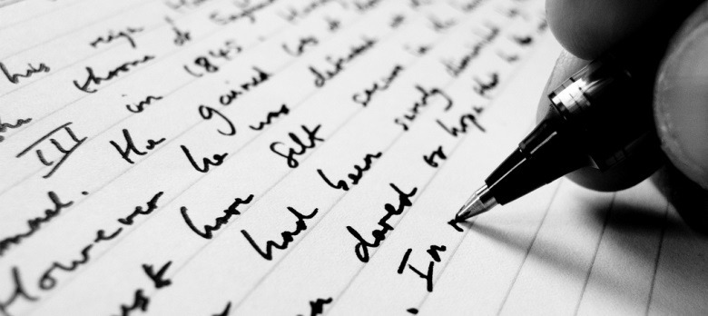
How to summarise
Before you start writing a summary:
Read the text carefully and make sure you understand everything
Use a dictionary to understand difficult words
While you are reading your book, make notes of the most important things

Slide 14
How to summarise
While you are writing your summary:
Keep in mind that a summary should be brief (short) and easy to read
Don’t forget to inculde any of the most important happenings of your story
Don’t include unimportant details in your summary
In a summary, you are supposed to tell the ending of your story

Slide 15
How to summarise
After you have written your summary:
Re-read it and check if you have included all of the most important elements of your story
Check if you haven’t written down too many details
Your summary shouldn’t contain anything that doesn’t support the general meaning of your book
Check for spelling and grammar mistakes

Slide 16

Recognise your main character (protagonist)
A novel revolves around your protagonist
You usually identify most with the protagonist
The protagonist changes throughout the story
They learn something in the story
They change their views about something
They are happier / unhappier because of something that happened in the story

Slide 17
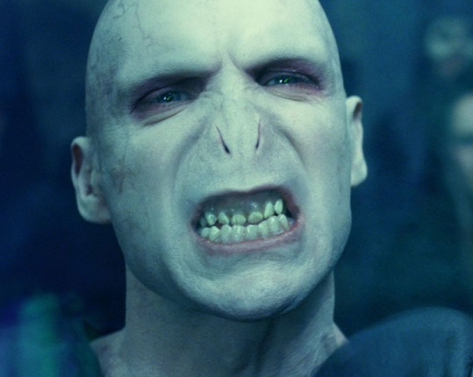
Recognise your main character (antagonist)
Very often, your protagonist is involved in some sort of battle against an ANTAGONIST.
An Antagonist can be one person, or a group of people.
The Antagonist oppose against the main character(s).

Slide 18

How to describe characters
Looks
Describe your characters´ age, height, general build
Skin colour, hair colour, eye colour etc.
What kind of clothes?
Personality
Typical personal aspects (kind, friendly, moody, angry etc.)
How do you know? Give examples (of behavior, facial expressions etc.)
Describe your character through his thoughts and actions

Slide 19

How to describe characters

Slide 20
How to describe characters
Describe one of the characters in your novel.
Describe how he/she looks in 3 lines.
Think about adjectives you can use to describe their look.
Describe his/her personality in 3 lines.
Think about adjectives you can use to describe their personality. Pay attention, these are different than the ones you use to describe someones look.

